Slide 1
LIBRARY INFORMATION SYSTEM
Developed by Coding Connoisseurs

Slide 2
ABOUT
With the increase in the number of readers and in the number of books, better management systems of libraries are required. The Library Information System focuses on improving the management of a Library, particularly in a university.
The integrated Library Information System provides you the ease of issuing, returning, or reserving a book from a Library within your campus through a simple application. The Library Information System focuses on the most fundamental tasks concerning a Library, alongside several other features that come in very handy in managing hundreds of thousands of books in a typical Library.

Slide 3
SDLC & IMPLEMENTATION

Slide 4
PRACTICES, TOOLS & TECHNIQUES
o ITERATIVE SDLC MODEL
o CRYPTOGRAPHY & HASHING
o THREADING
o MySQL DATABASE DRIVERS
o GRAPHICAL USER INTERFACE

Slide 5
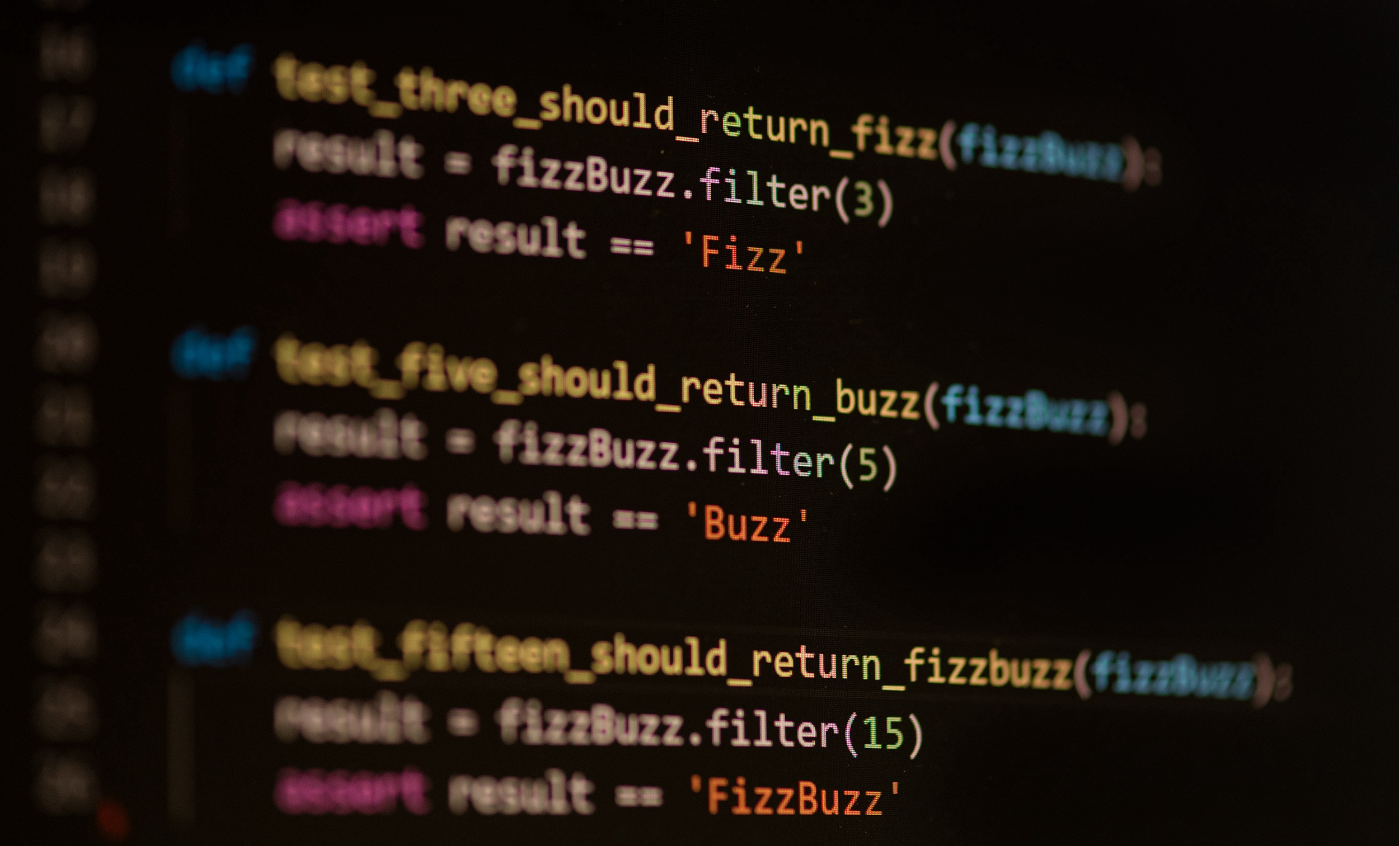

WHY PYTHON?

Slide 6
CHALLENGES
o COORDINATION
o KNOWLEDGE TRANSFER
o CONSISTENCY AND UNIFORMITY
o DECLINING PRODUCTIVITY

Slide 7
DESIGN & FEATURES

Slide 8
KEY FEATURES
o LOGIN LOGOUT MONITORING SYSTEM
o LIBRARIAN’S CONTROL PANEL
o CLERK’S CONTROL PANEL
o MEMBER’S CONTROL PANEL
o MESSAGING & REMINDER SYSTEM

Slide 9
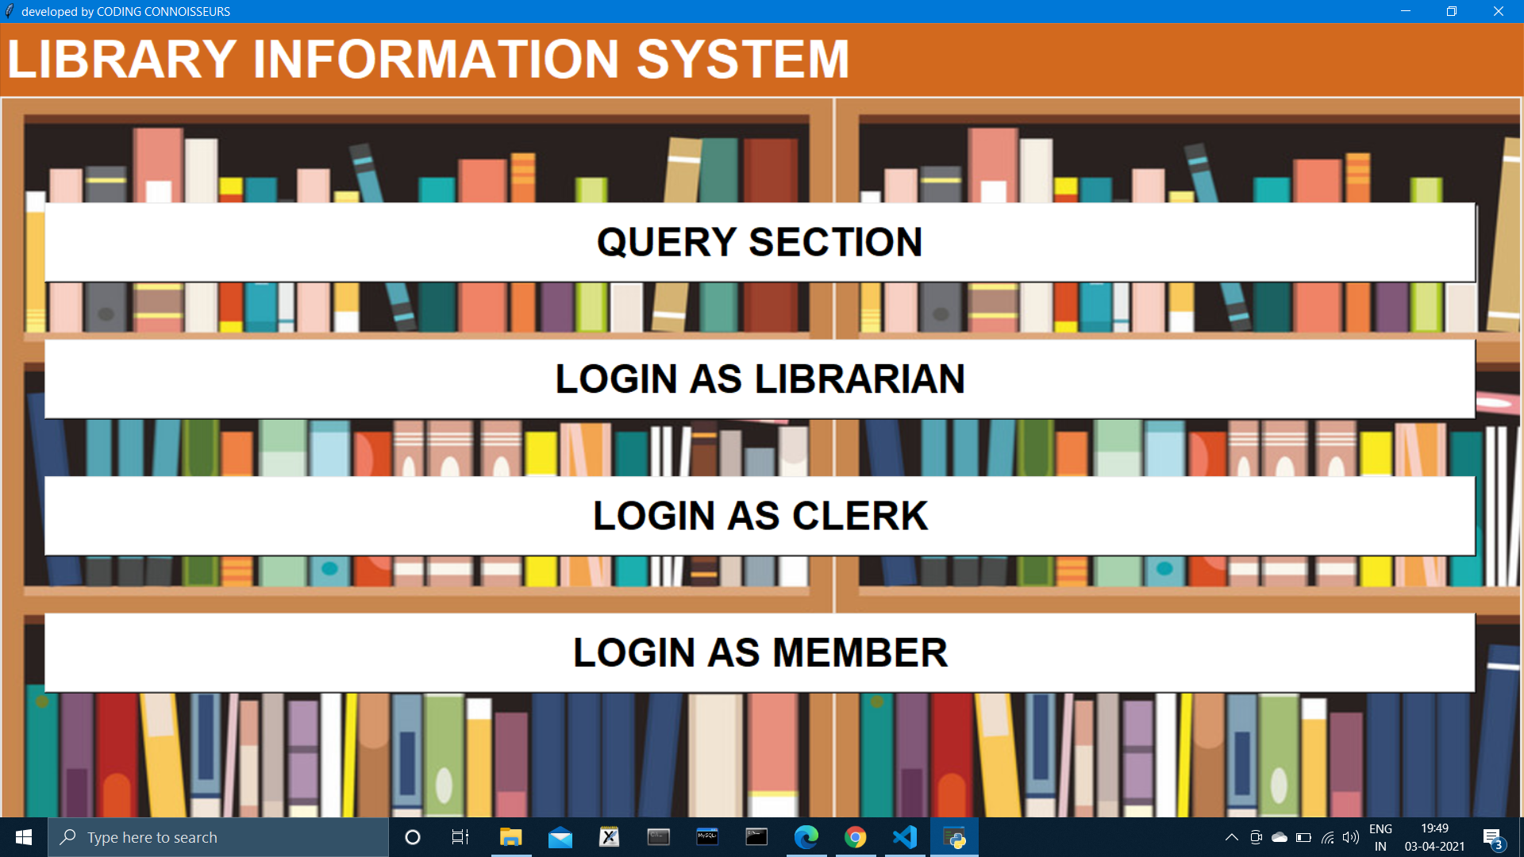
LOGIN MONITORING SYSTEM

Slide 10
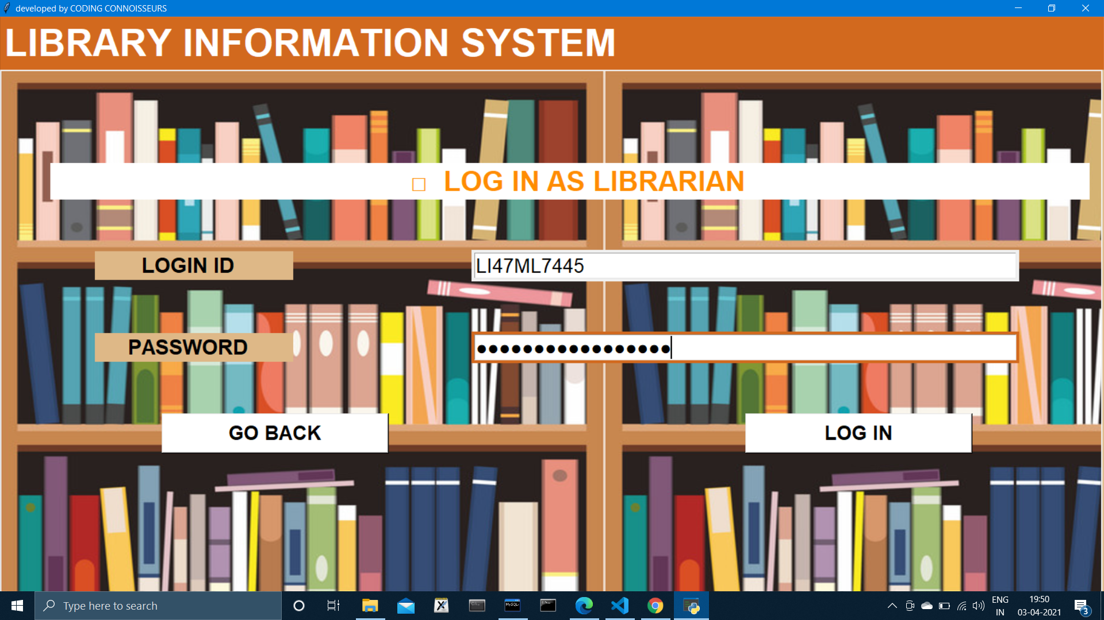
LOGIN MONITORING SYSTEM

Slide 11
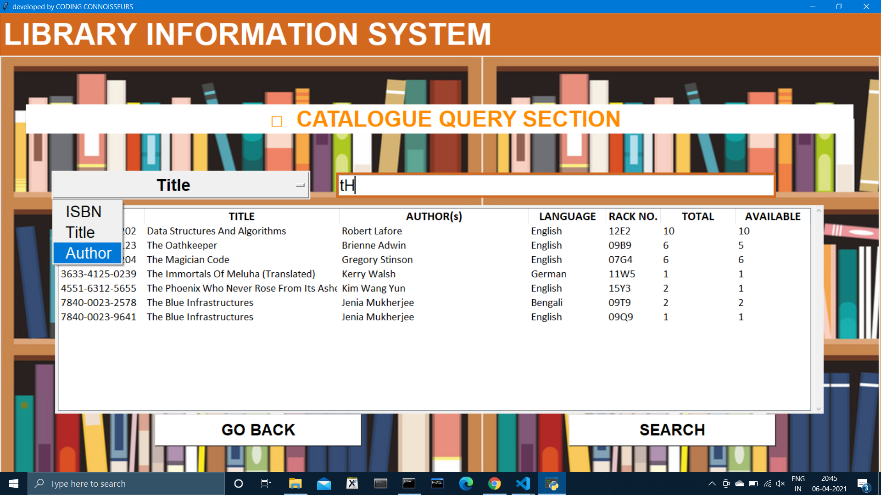
CATALOGUE QUERY SECTION

Slide 12
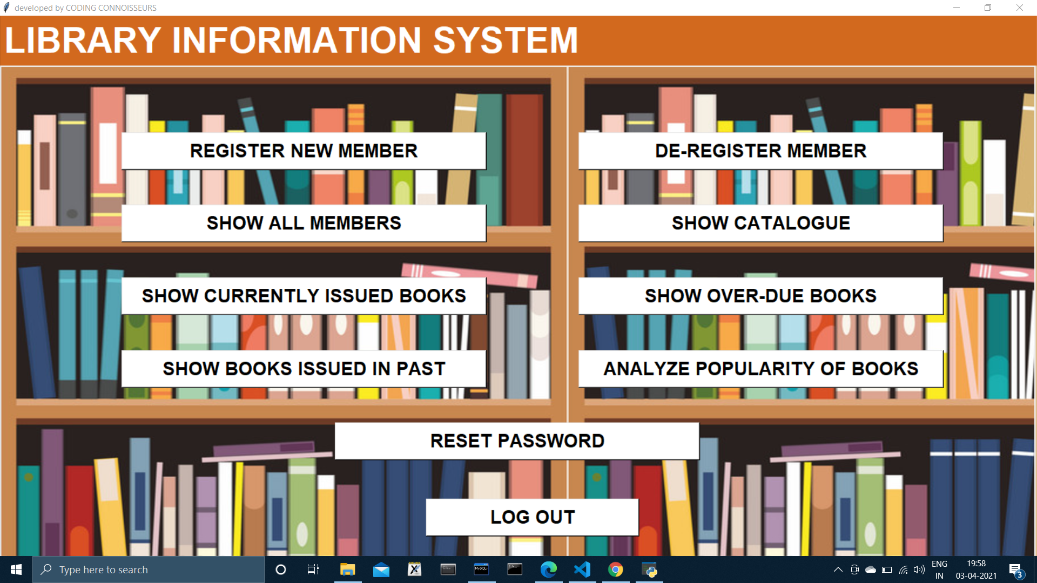
LIBRARIAN’S CONTROL PANEL

Slide 13
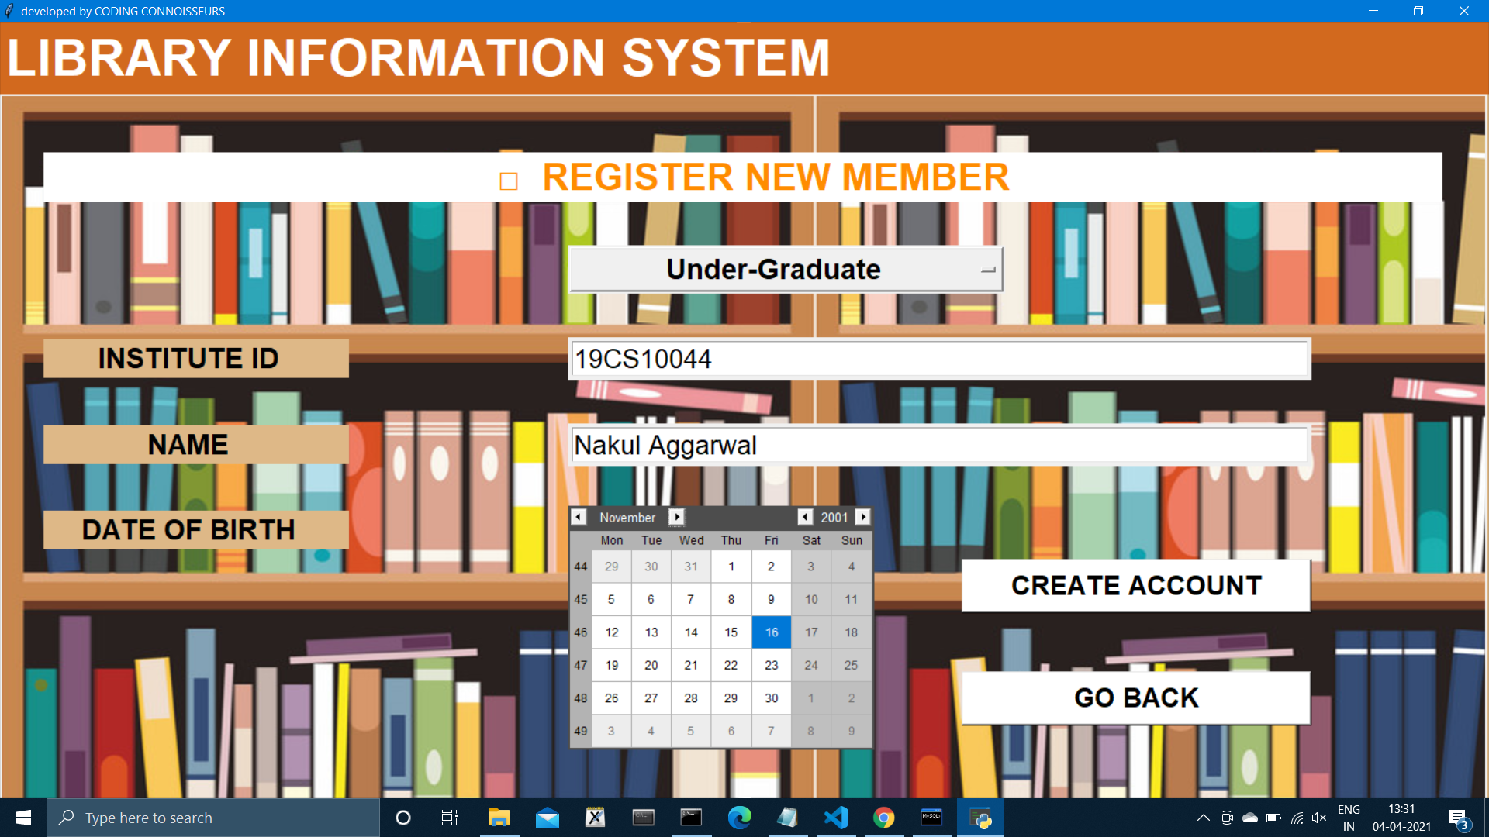
REGISTRATION

Slide 14
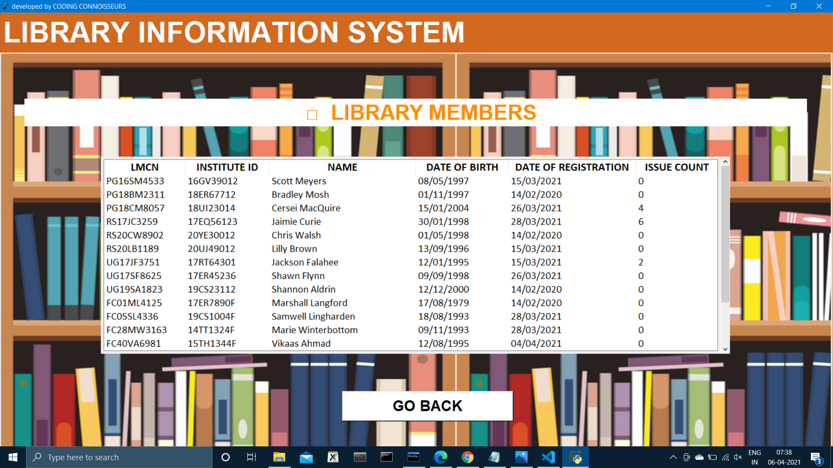
LIBRARY MEMBERS

Slide 15
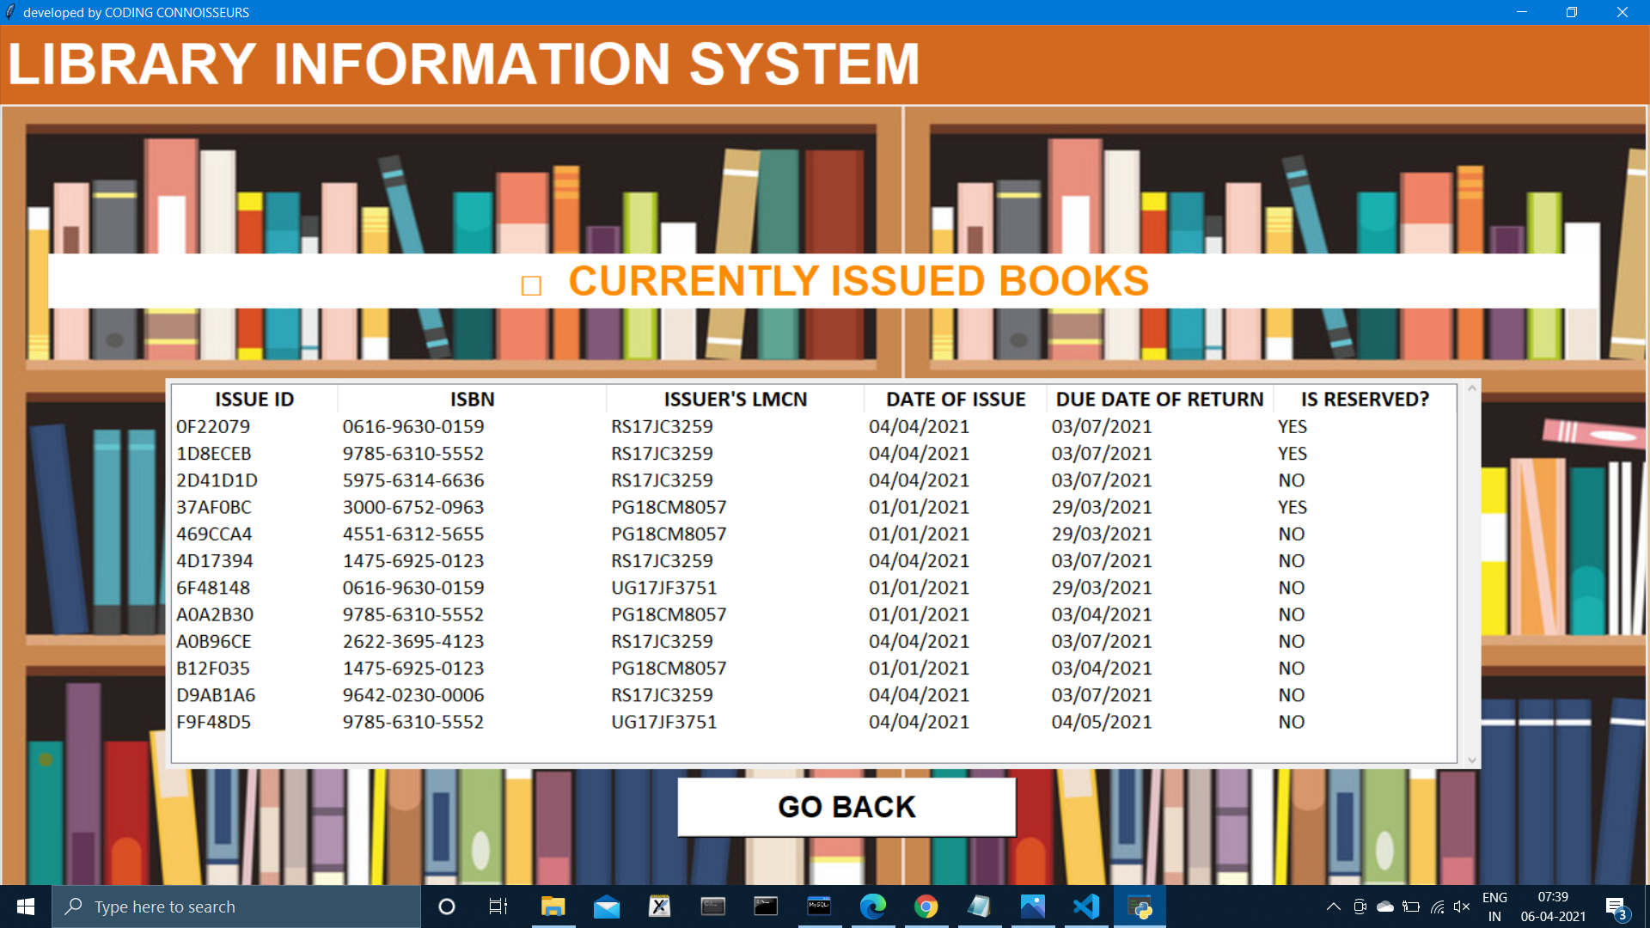
LIBRARY’S ACTIVITY

Slide 16
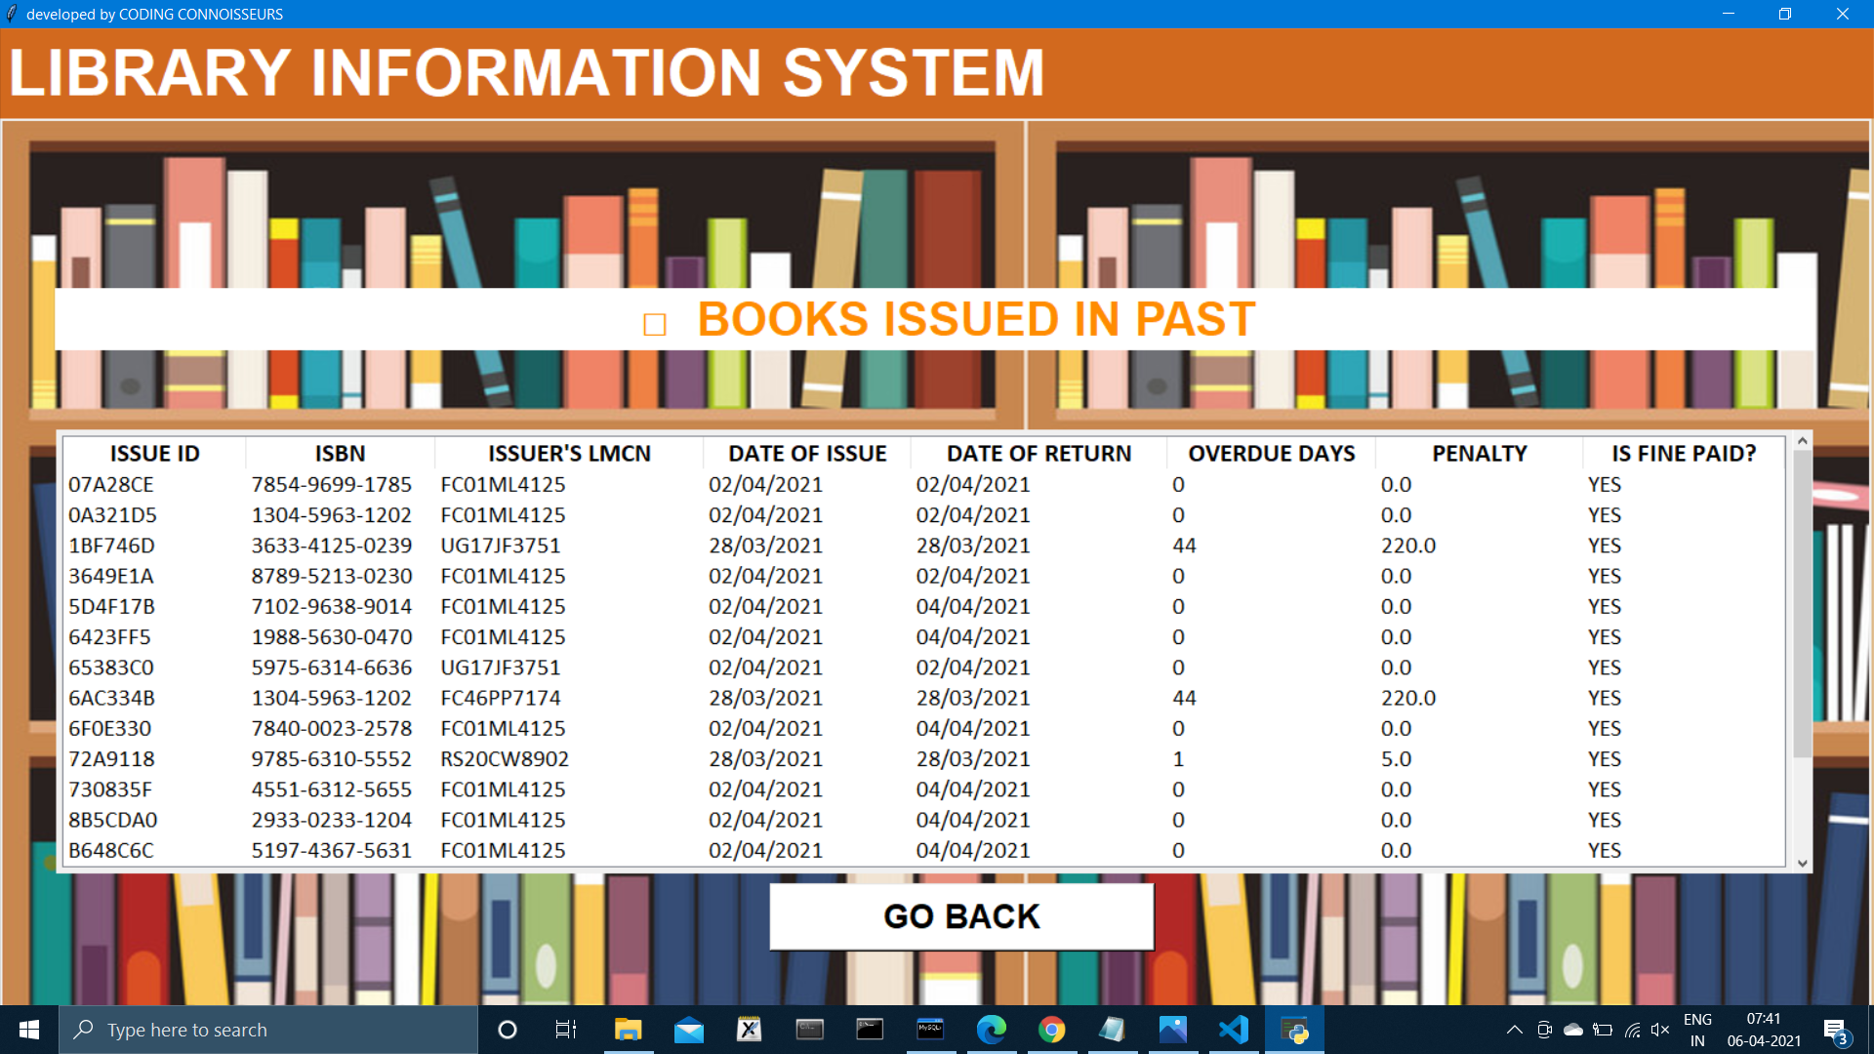
LIBRARY’S ACTIVITY

Slide 17
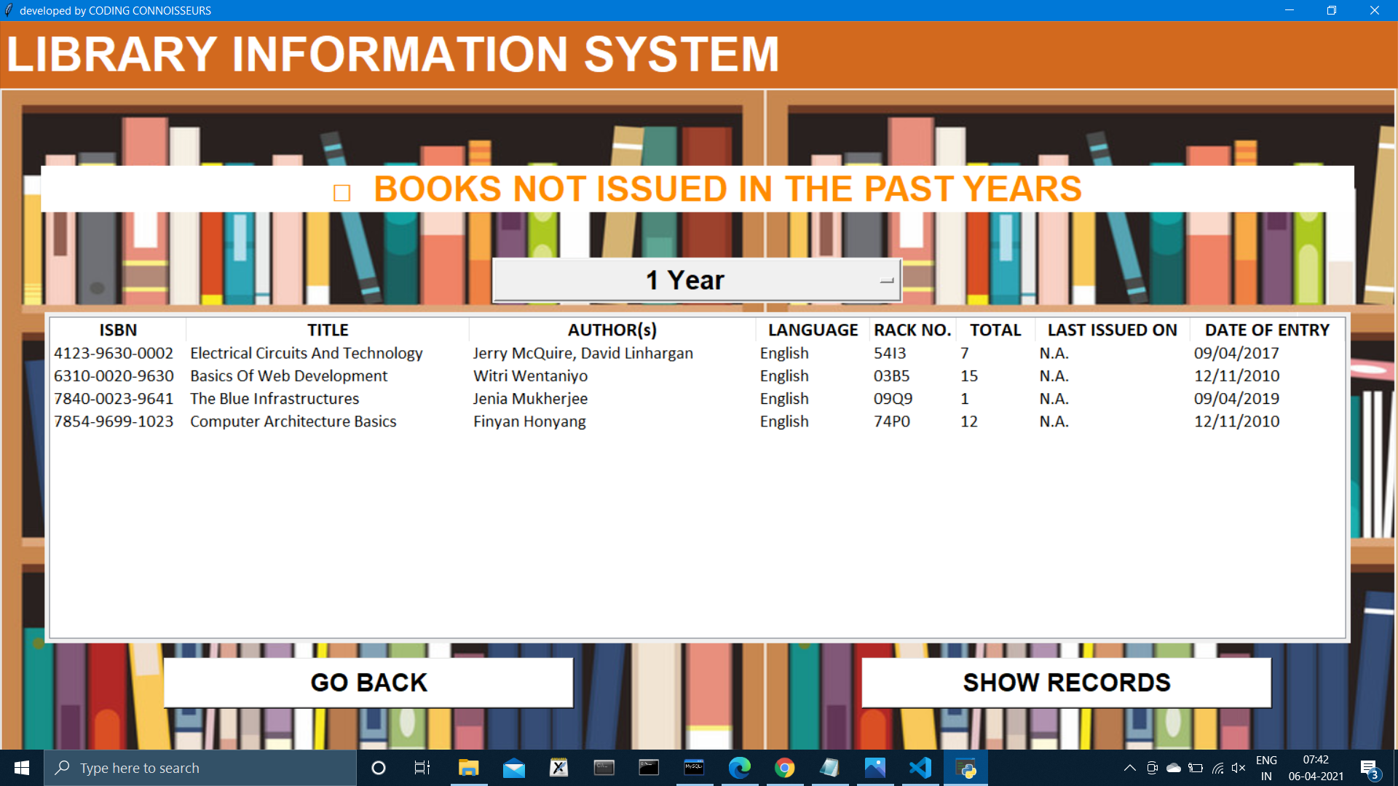
POPULARITY OF BOOKS

Slide 18
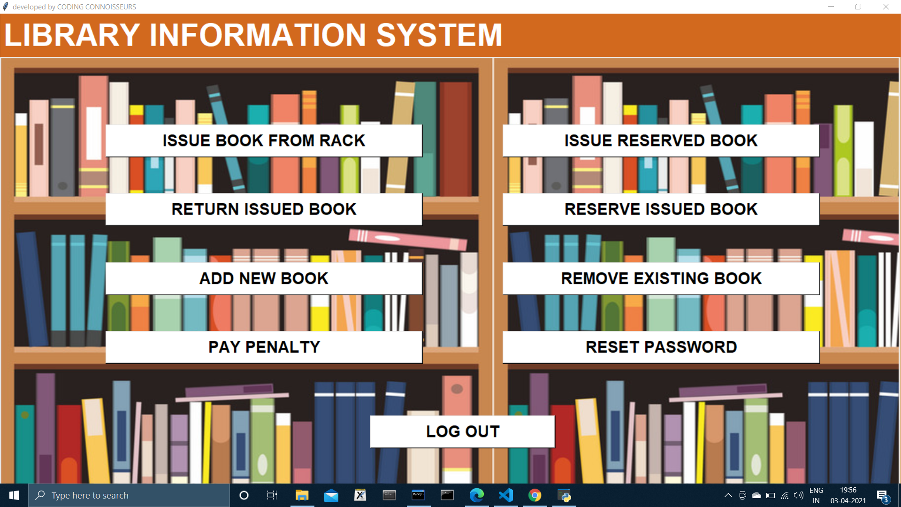
CLERK’S CONTROL PANEL

Slide 19
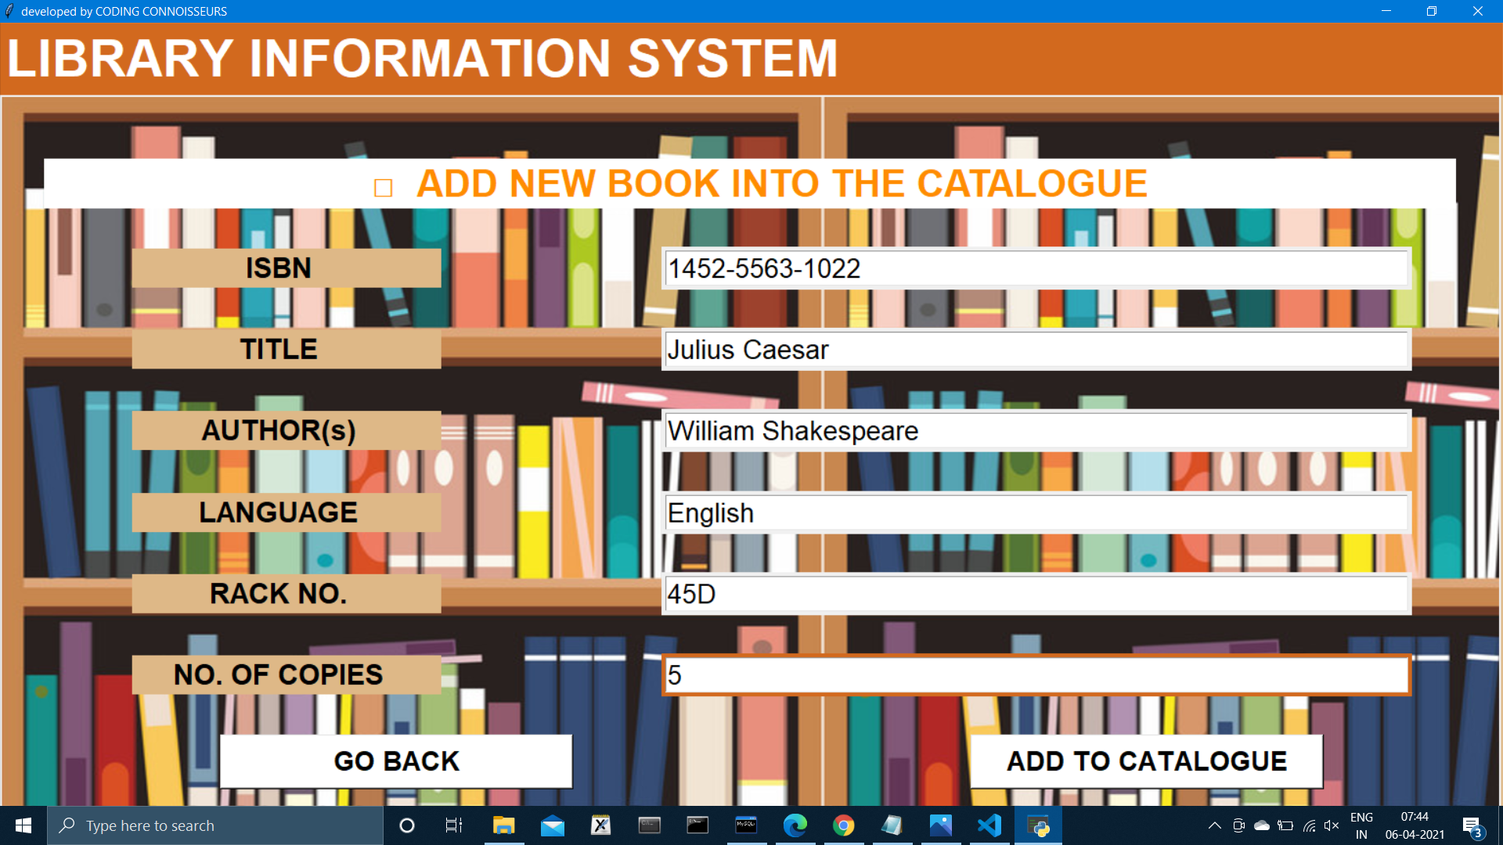
UPDATING CATALOGUE

Slide 20
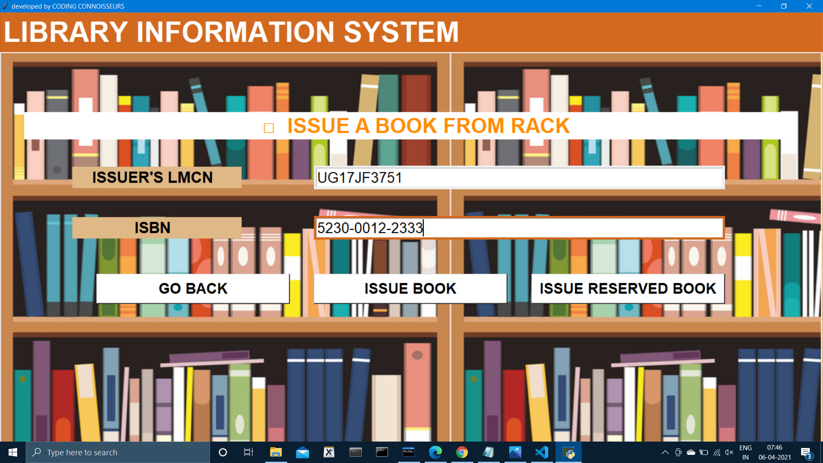
ISSUING A BOOK

Slide 21
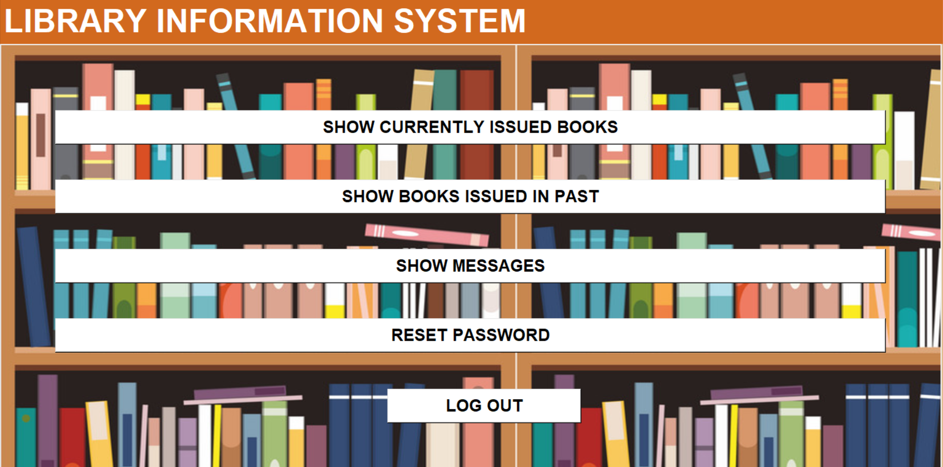
MEMBER’S CONTROL PANEL

Slide 22
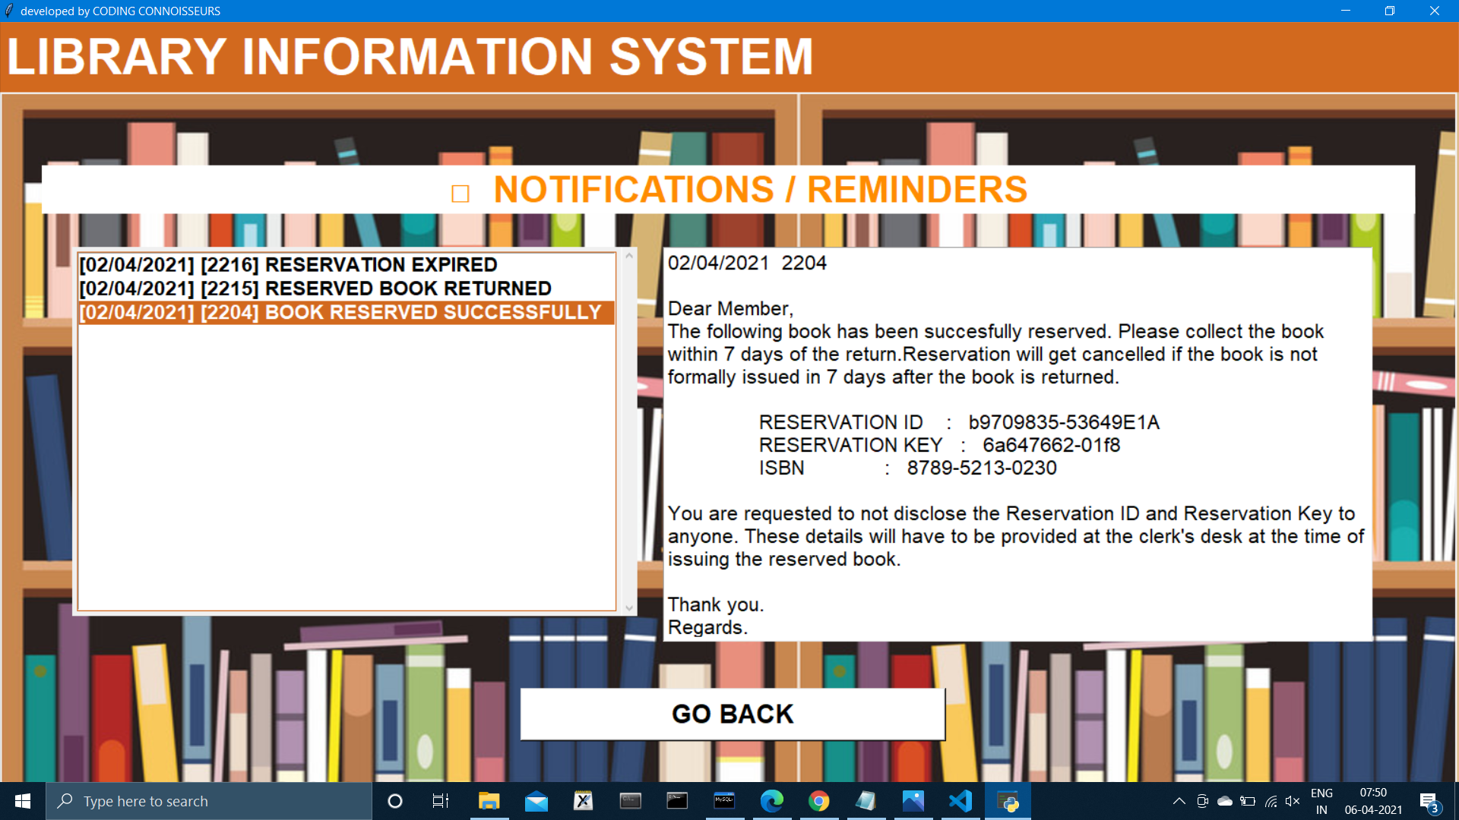
MESSAGES & REMINDERS

Slide 23
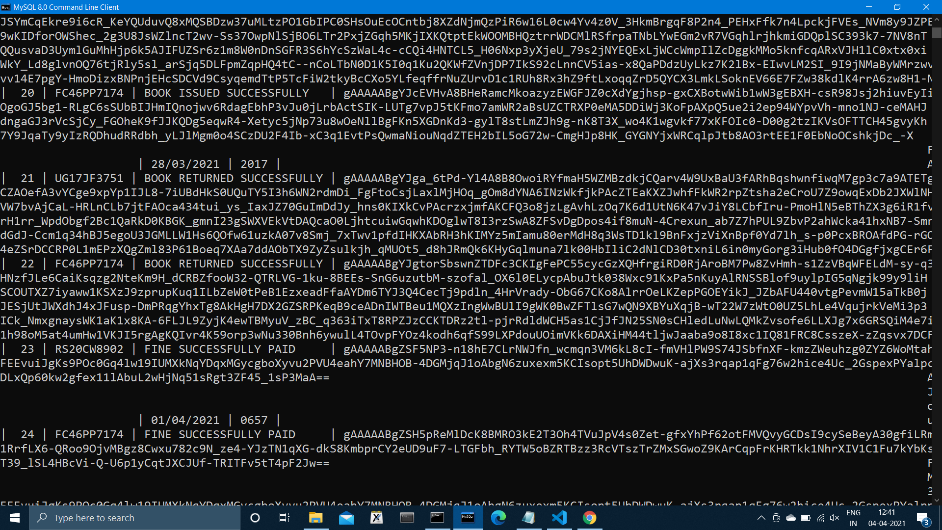
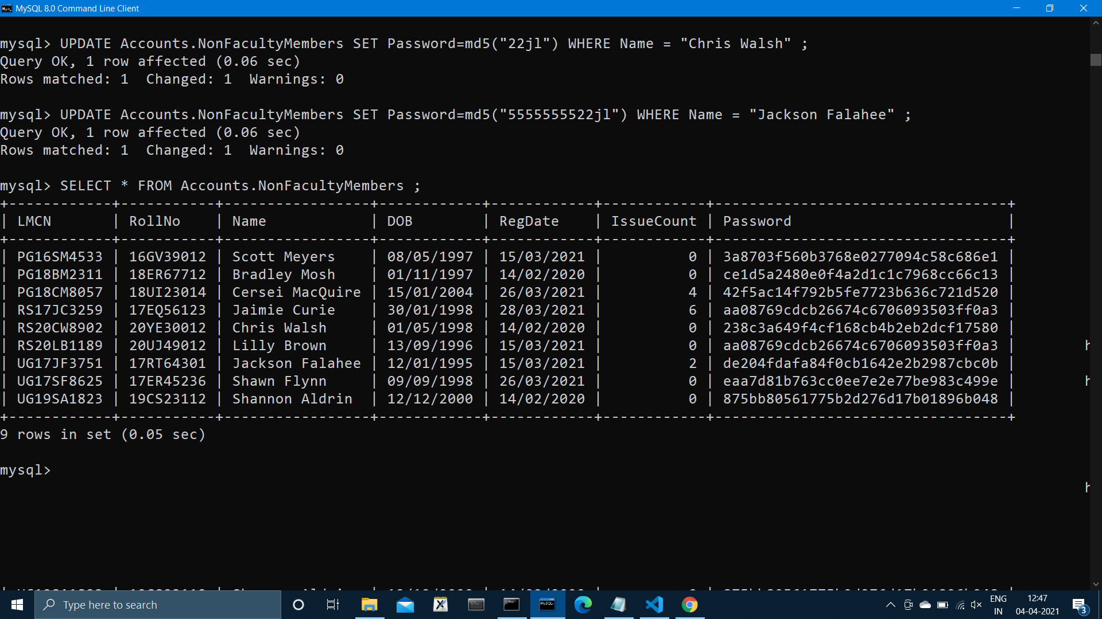
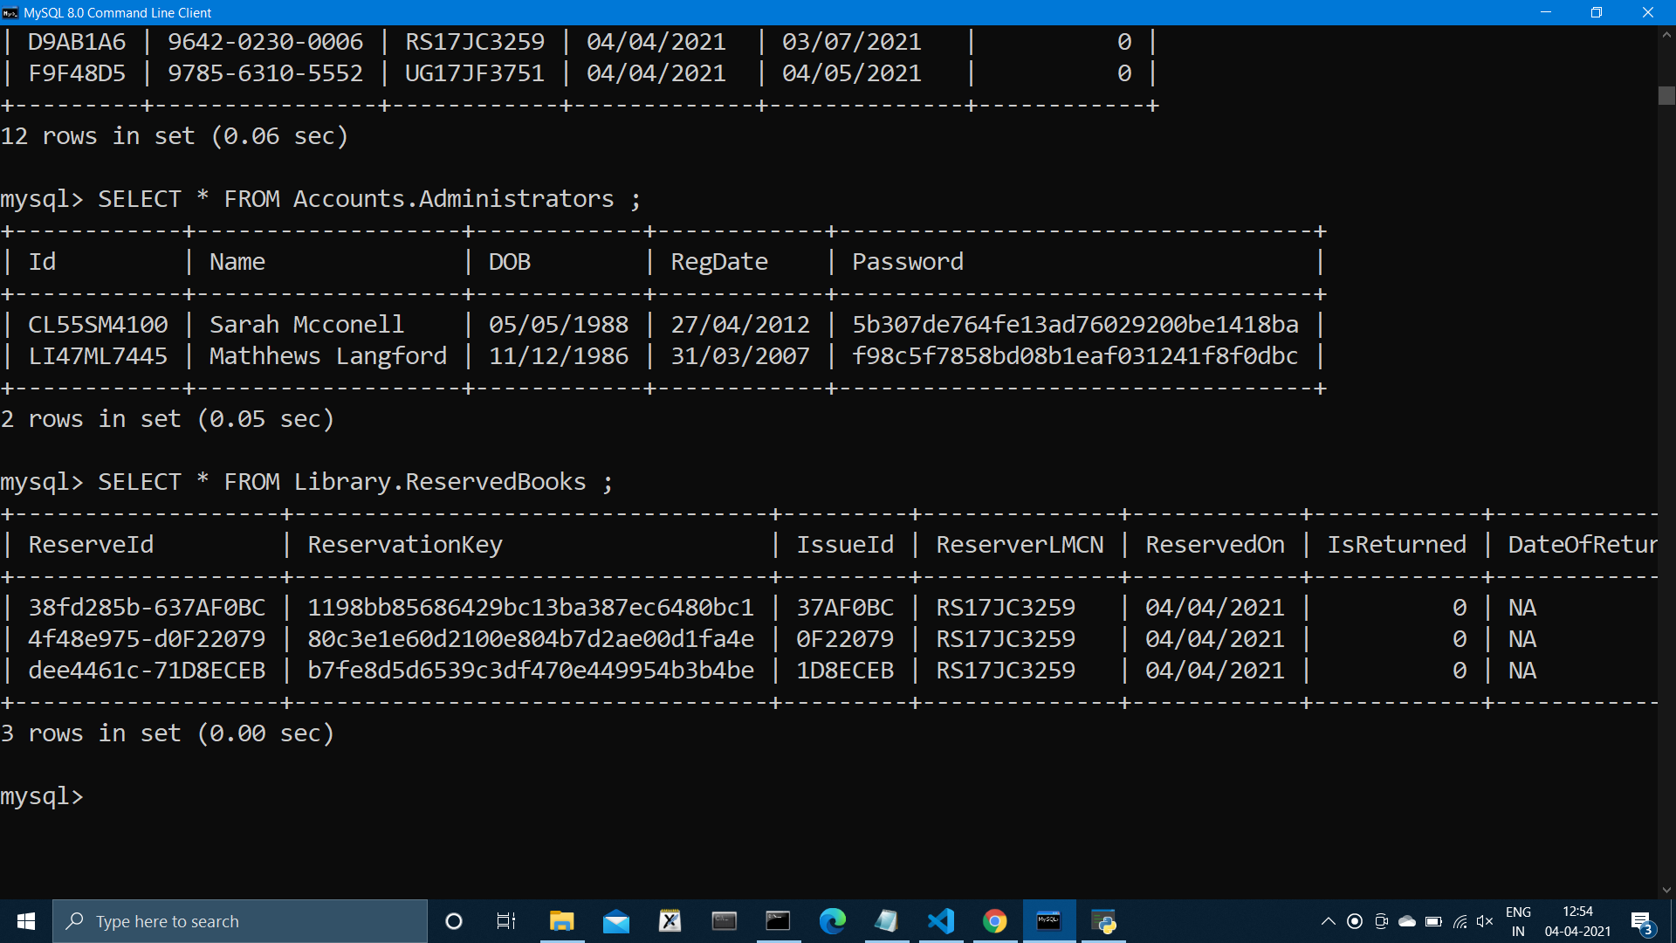
SECURITY & PRIVACY

Slide 24
WHAT NEXT ?

Slide 25
o CACHE MANAGEMENT SYSTEM
o QUERY COMPLETION / NLP
o QUERY CORRECTION / Word2Vec
o SESSION ACTIVITY & TIMEOUT
o AI CHATBOT FOR MEMBERS

Slide 26
THANK YOU

